Slide 1
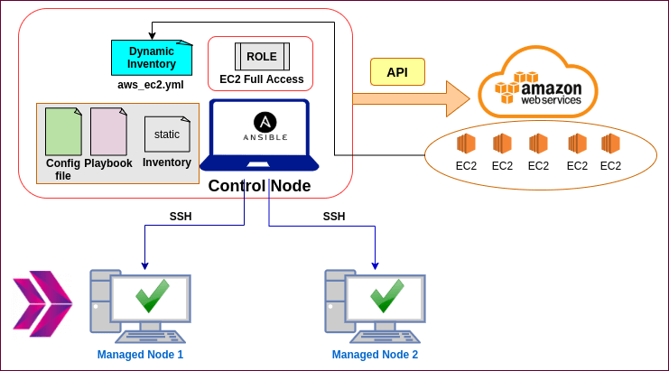
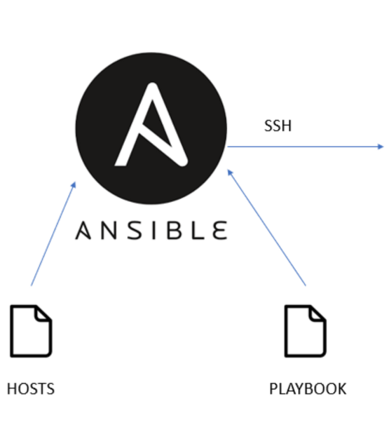

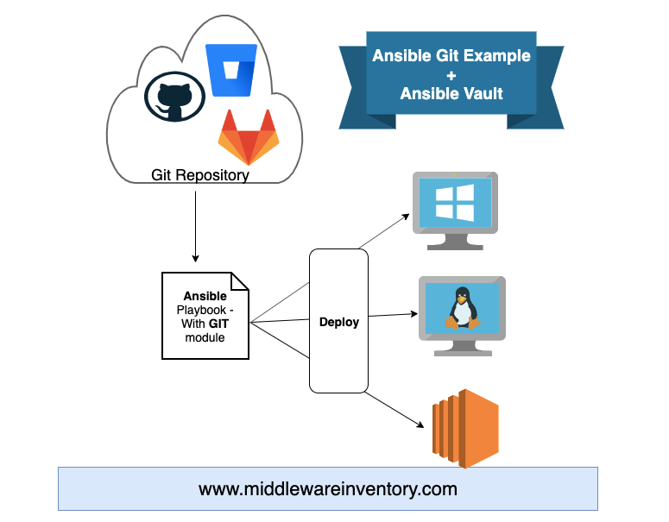
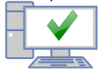

Slide 2
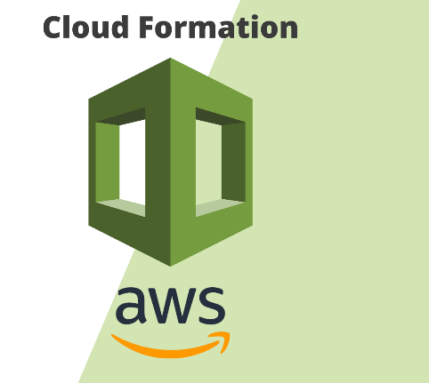
Process 1
Create an Controle Node (Ansible Instance) by using
Cloud Formation Service
Controle Node
Process 2
Create a new instance by using Ansible
(Playbook 1)
Managed Node
(New Instance)
Controle Node
Process 3
Configure instance by using Ansible
(Playbook 2)
Managed Node
(Grafana Instance)

Slide 3

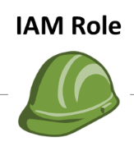
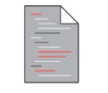
Process 1
Create a Controle Node (Ansible Instance) by using
Cloud Formation Service
Controle Node
(Ansible Instance)
+
CloudFormation Template

Slide 4

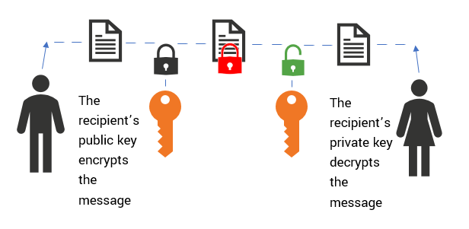
Process 2
Create a new instance by using Ansible (Playbook 1)
Controle Node
Managed Node
(New Instance)
+
+
+
Create playbook_1_create_a_new_instance.yml
Configure default inventory (host) file by adding “localhost”
Create user-data.sh
Copy your own “…….”key.pem

Slide 5
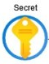
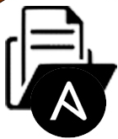
Docker Compose File
Controle Node
Managed Node
(Grafana Instance)
Process 3
Configure instance by using Ansible (Playbook 2)
+
+
Add dynamic inventory file
Create playbook_2_configure_instance.yml
Create secrets.yml

